Slide 1

Note: The data and information in this document is reflective of a hypothetical situation and client. This document is to be used for KPMG Virtual Internship purposes only.
Sprocket Central Pty Ltd
Data analytics approach
Monica Sethuraman

Slide 2
Note: The data and information in this document is reflective of a hypothetical situation and client. This document is to be used for KPMG Virtual Internship purposes only.
Agenda
Introduction
Data Exploration
Model Development
Interpretation

Slide 3
Note: The data and information in this document is reflective of a hypothetical situation and client. This document is to be used for KPMG Virtual Internship purposes only.
Introduction
Identify and recommend top 1000 customers to target from datasets
Outline of problem
Sprocket central is a company that specializes in high- quality bikes and cycle accessories
Their marketing team is looking ti boost business sales by analysing provided datasets.
Using the data sets provided the aim is to analyze and recommend 1000 customers that sprocket central should target to drive higher value for company.
Contents Of Data Analysis
‘New’ and ‘Old’ Customer Age distributions
Bike related purchases over the last 3 years by gender
Job industry distributions
Wealth segmentation by age category
Number of cars owned and not owned by state
RFM analysis and customer classification

Slide 4
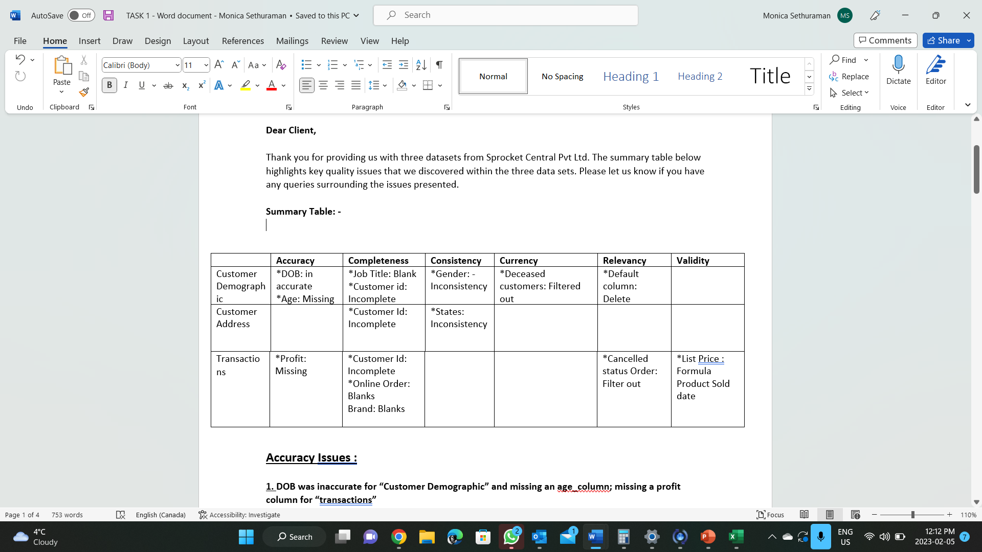
Note: The data and information in this document is reflective of a hypothetical situation and client. This document is to be used for KPMG Virtual Internship purposes only.
Data Exploration
Data Quality Assesment and ‘Cleanup’
Key issues for data quality assessment
Accuracy : Correct Values
Completeness : Data field with values
Consistency : Value free from contradiction
Currency : Value up to date
Relevancy : Data items with values meta data
Validity : Data Containing allowable values
Uniqueness : Records that are duplicated A deep analysis has been sent via E-mail.
Place any supporting images, graphs, data or extra text here.

Slide 5
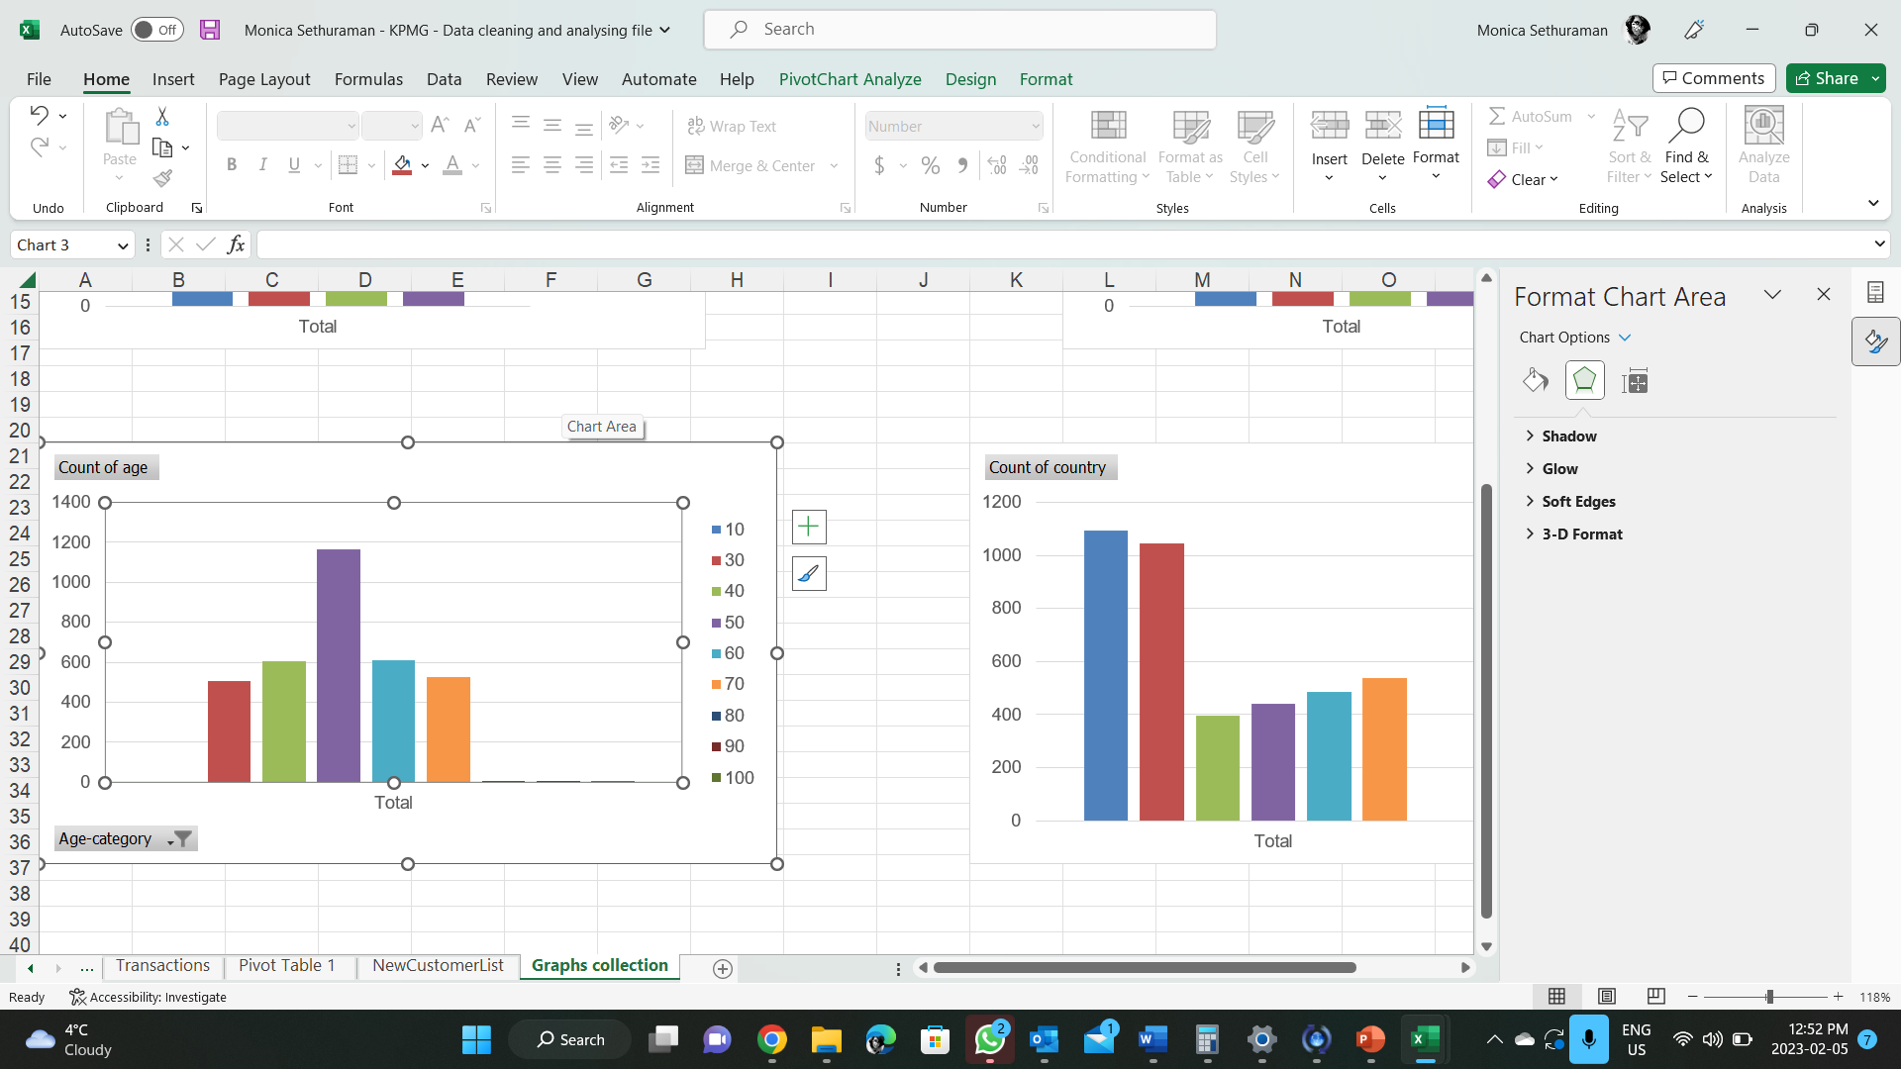
Note: The data and information in this document is reflective of a hypothetical situation and client. This document is to be used for KPMG Virtual Internship purposes only.
Data Exploration
Customer age distributions
Most customers are aged between 30-60
Lowest age group falls between 70-80
There is a steady increase in the age where it peaked upto 1850 which ranges between 30-40.
Place any supporting images, graphs, data or extra text here.

Slide 6
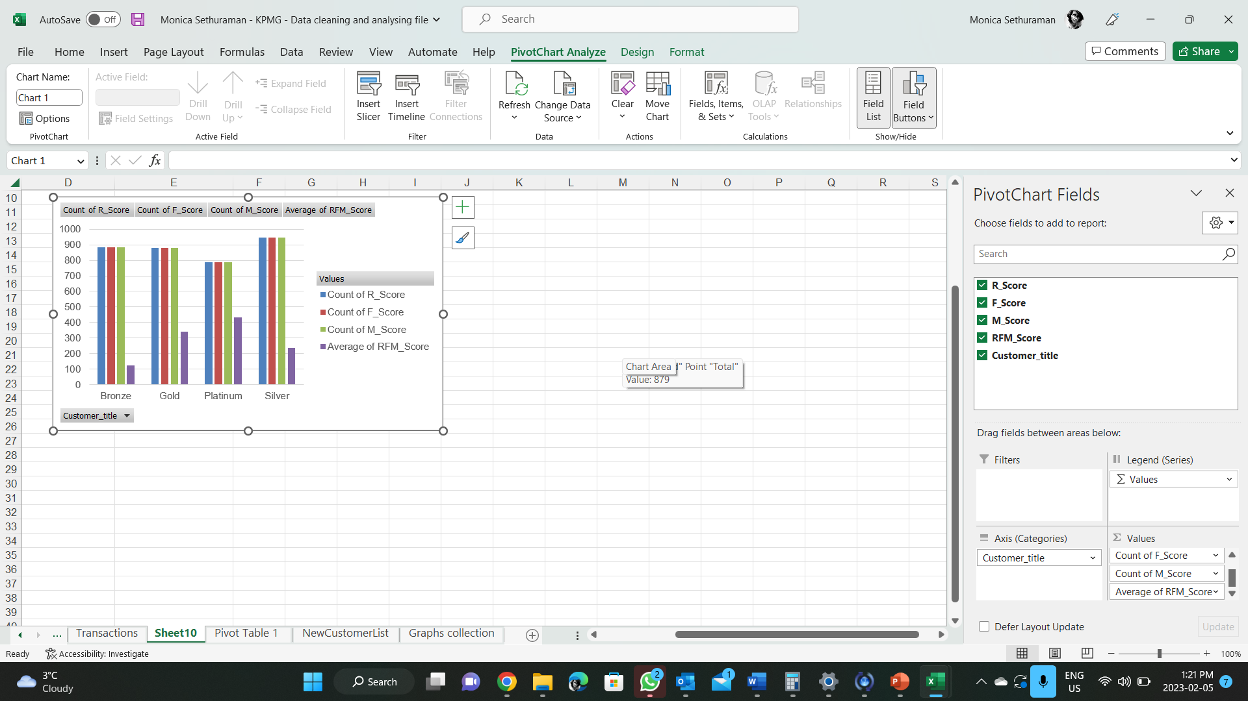
Note: The data and information in this document is reflective of a hypothetical situation and client. This document is to be used for KPMG Virtual Internship purposes only.
Model Development
RFM Analysis
RFM analysis is used to determine which customer business should target to increase its revenue and value
The regency , monetary and frequency model shows that customers that have displayed high level of engagement with the business in four categories mentioned.
Place any supporting images, graphs, data or extra text here.

Slide 7
Note: The data and information in this document is reflective of a hypothetical situation and client. This document is to be used for KPMG Virtual Internship purposes only.
Interpretation
Summary table of top 1000 customers to target
Rank | Customer title | Description | Number of Customers | Cumulati326ve | Customer Selection
1 | Platinum customer | Most recent buy , buys often | 176 | 176 | 176
2 | Very Loyal | Most recent buy , buys often , spends large amount of money. | 184 | 360 | 184
3 | Becoming Loyal | Relatively recent, bought more than once, spends large amount of money. | 344 | 704 | 344
4 | Recent Customer | Bought recently, not very often , average money spent | 368 | 1072 | 296
5 | Late Bloomer | No purchase recently, but RFM value higher than average | 355 | 1427 | 0
6 | Potential Customer | Bought recently, never bought before, spent small amount | 356 | 1760 | 0
7 | Losing Customer | Purchases was a while ago, below average RFM vaue | 360 | 2116 | 0

Slide 8
Note: The data and information in this document is reflective of a hypothetical situation and client. This document is to be used for KPMG Virtual Internship purposes only.
Interpretation
Customers target and Methodology
Rank | Customer title | Description | Number of Customers | Cumulati326ve | Customer Selection
1 | Platinum customer | Most recent buy , buys often | 176 | 176 | 176
2 | Very Loyal | Most recent buy , buys often , spends large amount of money. | 184 | 360 | 184
3 | Becoming Loyal | Relatively recent, bought more than once, spends large amount of money. | 344 | 704 | 344
4 | Recent Customer | Bought recently, not very often , average money spent | 368 | 1072 | 296
Filter through the top 1000 customers by assigning the condition discussed in the table above
The 1000 customers discovered would have bought recently,they have bought very frequently in the past and tend to spend more than other customers.

Slide 9
Note: The data and information in this document is reflective of a hypothetical situation and client. This document is to be used for KPMG Virtual Internship purposes only.
Thank you

